Slide 1
Pricing strategies introduction
Pricing Strategies
2025
Jean-Pierre Dubé
© Copyright 2024

Slide 2



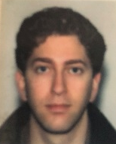
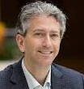






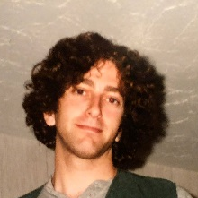

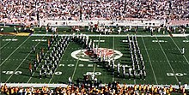


About Me…
Collaborations with
Companies …
Chicago Booth
NBER
BSc Econ Math, French Lit
University of Toronto
Research Interests
Customer analytics Topics:
MSc and PhD Economics, Northwestern
Pricing
Branding
Advertising
Public Policy

Slide 3
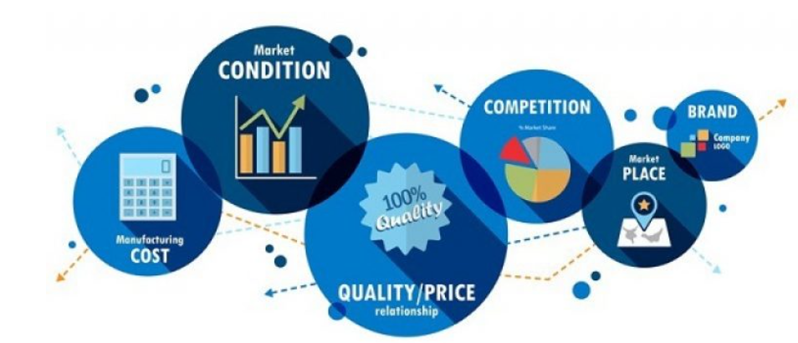
About the Pricing Strategy course …

Slide 4

Course TA
Arjun Gopinath
Ph.D. Student, Chicago Booth
arjung@uchicago.edu
Arjun is post-doc at the University of Chicago, with a Ph.D. in Economics from the University of Chicago. He previously worked as a research professional at UChicago and graduated with an MSc in Economics from University College London.
Notes:
Homework
Knowledge is power.
We want to turn data into knowledge.

Slide 5
Administrative Points
This is an almost paper-free course
Web Site: canvas.uchicago.edu
Download & read syllabus, course schedule & assignments handout
All lecture slides posted online
All assignments submitted via Canvas
Textbooks
Nagle, Müller & Gruyaert, The Strategy & Tactics of Pricing, 7th ed., 2023
Dolan & Simon, Power Pricing, 1996.
Notes:
Homework
Knowledge is power.
We want to turn data into knowledge.

Slide 6
Administrative Points Zoom
I will hold all 5 lectures in person
must obtain administrative approval to view live broadcast via Zoom

Slide 7
Extra case studies
I have pre-recorded several short pricing case studies
I also included “extra” slide decks with other pricing topics not covered in our 5-day course.
You can access these extra recordings and slides on Canvas
I appreciate that many of you are already overwhelmed with our course schedule and your jobs…
These extras are not part of the course evaluation and watching them is totally optional.

Slide 8
Use of AI
AI tools (e.g., ChatGPT, Claude, Deepseek etc) forbidden for case studies
i.e., CMI & Keurig
Why?
Explicit copyright violation (illegal)
Defies purpose of case study as a management strategy simulation
Using AI tools for case studies violates University’s academic integrity policy
I treat potential academic integrity violations as honor code violations.

Slide 9
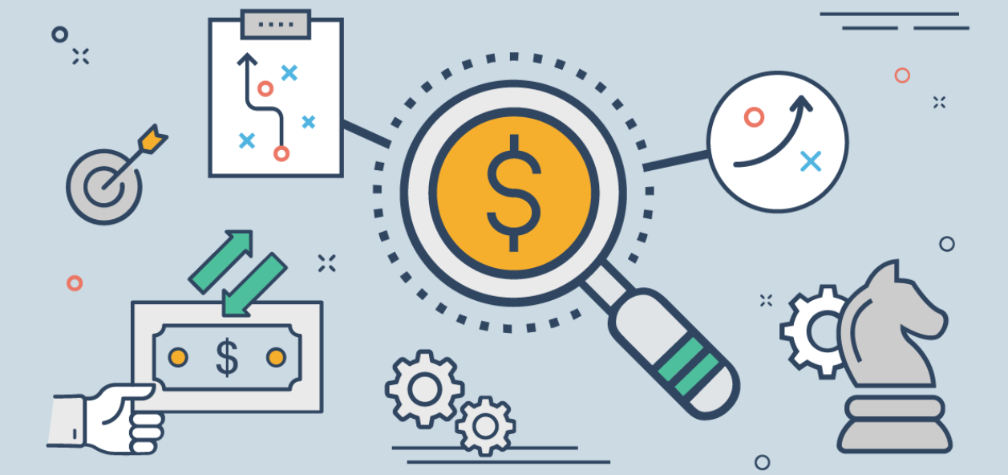
And Now About Pricing …

Slide 10
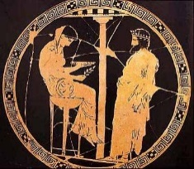
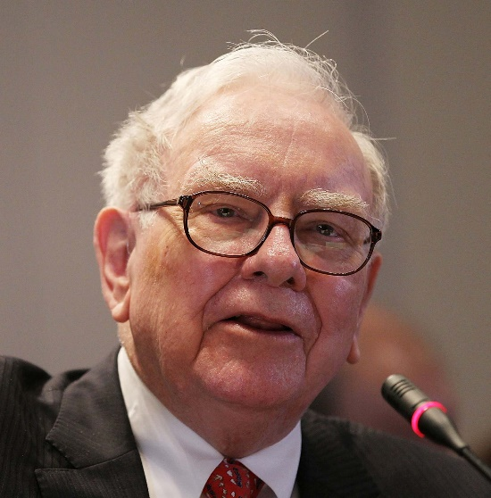
The Wisdom of the Oracle of Omaha
10
“The single most important decision in evaluating a business is pricing power.”
Warren Buffet, Chairman & CEO Berkshire Hathaway
Pricing is a fundamental marketing decision.
Ton of evidence that better pricing has short- & long-term LR ROI.
Yet, the practice of pricing remains woefully inefficient.

Slide 11
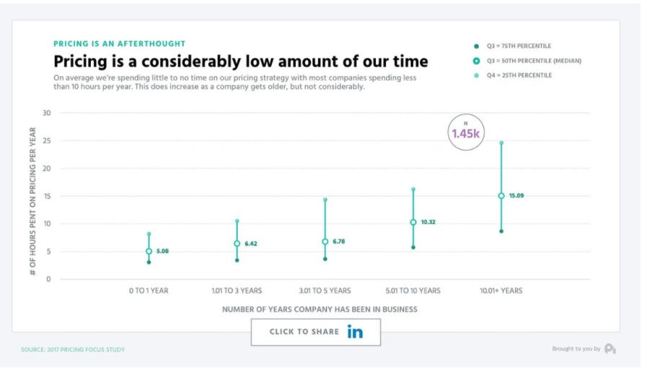
Firms spend little effort on pricing
Average firm spends less than 10 hours per year on pricing

Slide 12
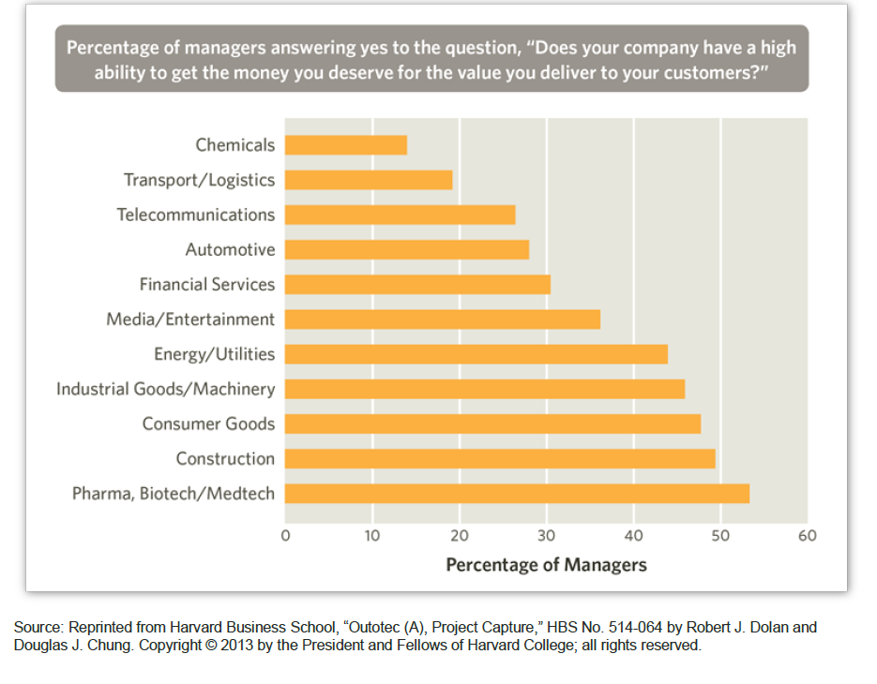
Most managers skeptical of own pricing

Slide 13
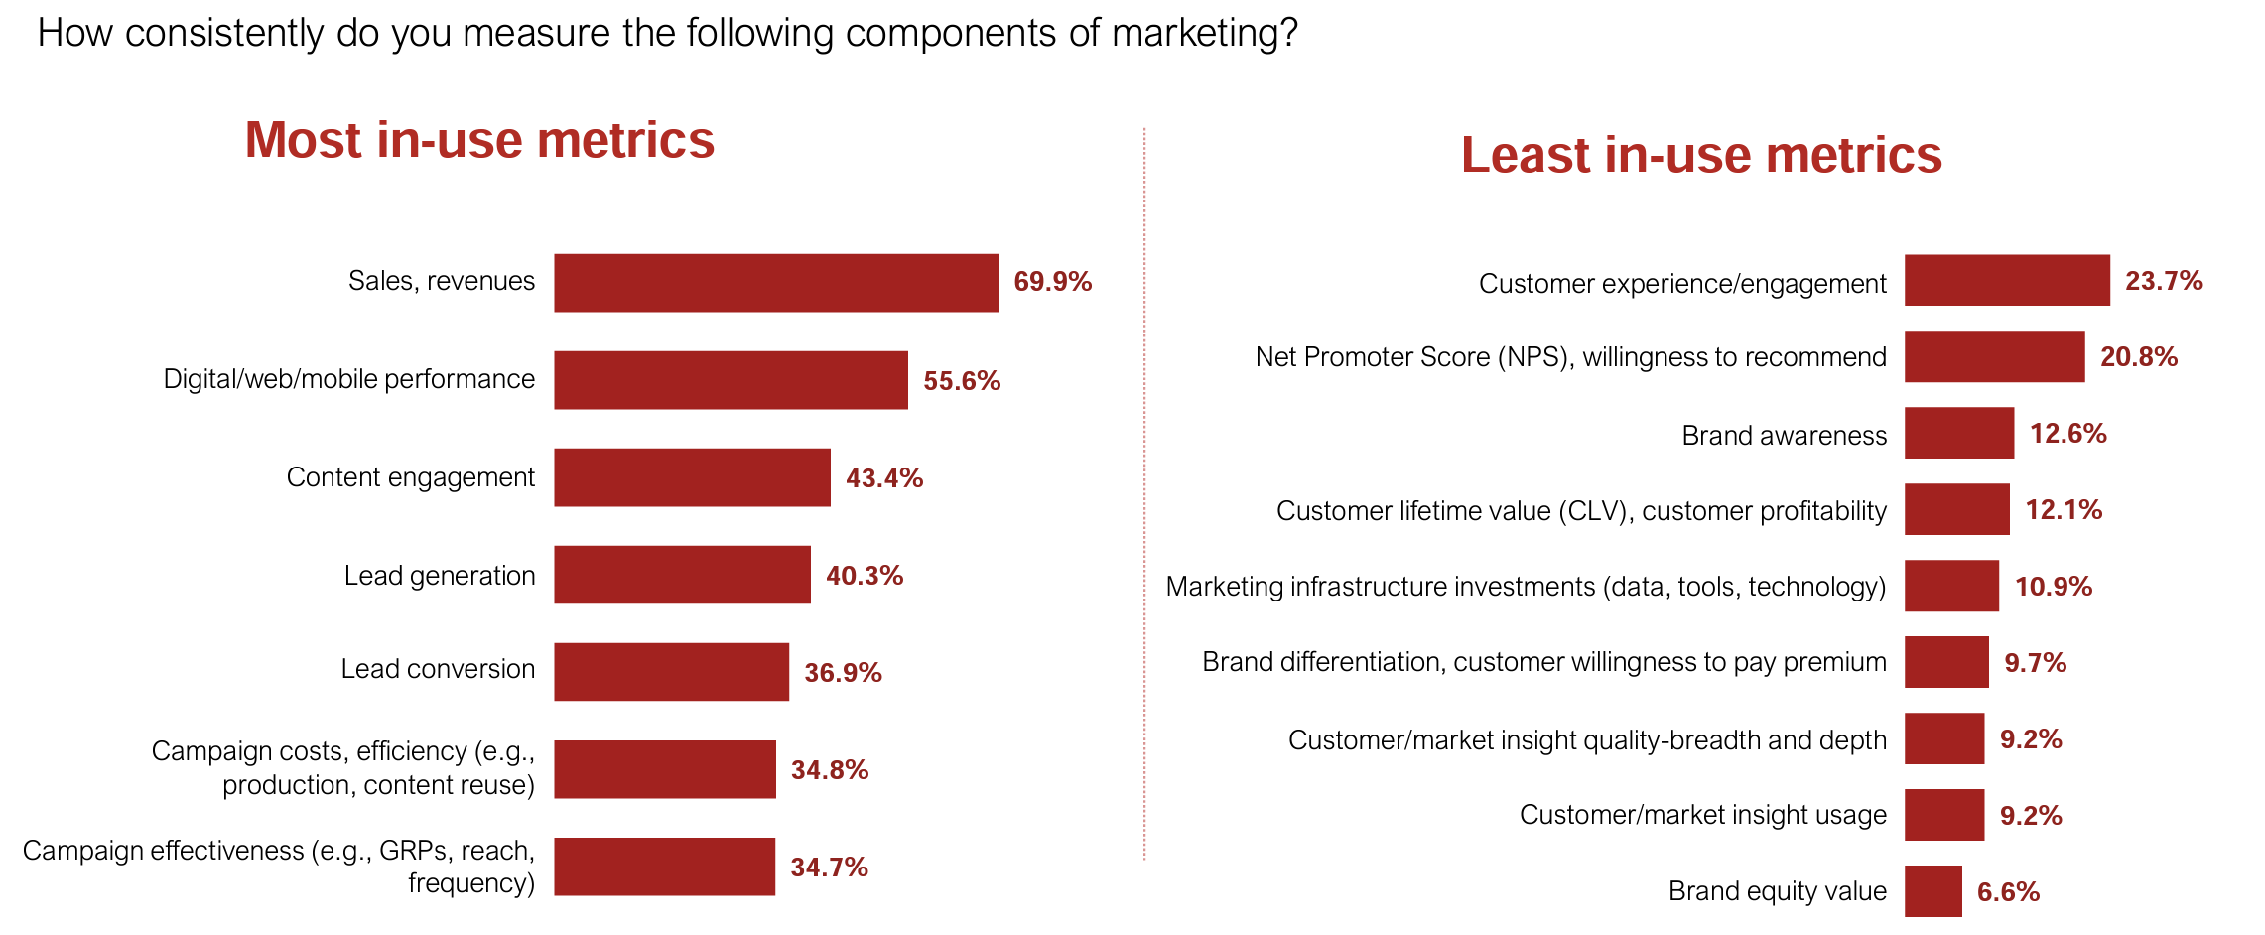
Most managers ignore willingness-to-pay!!!
Source: CMOSurvey.org, 2023 (slide 67)

Slide 14
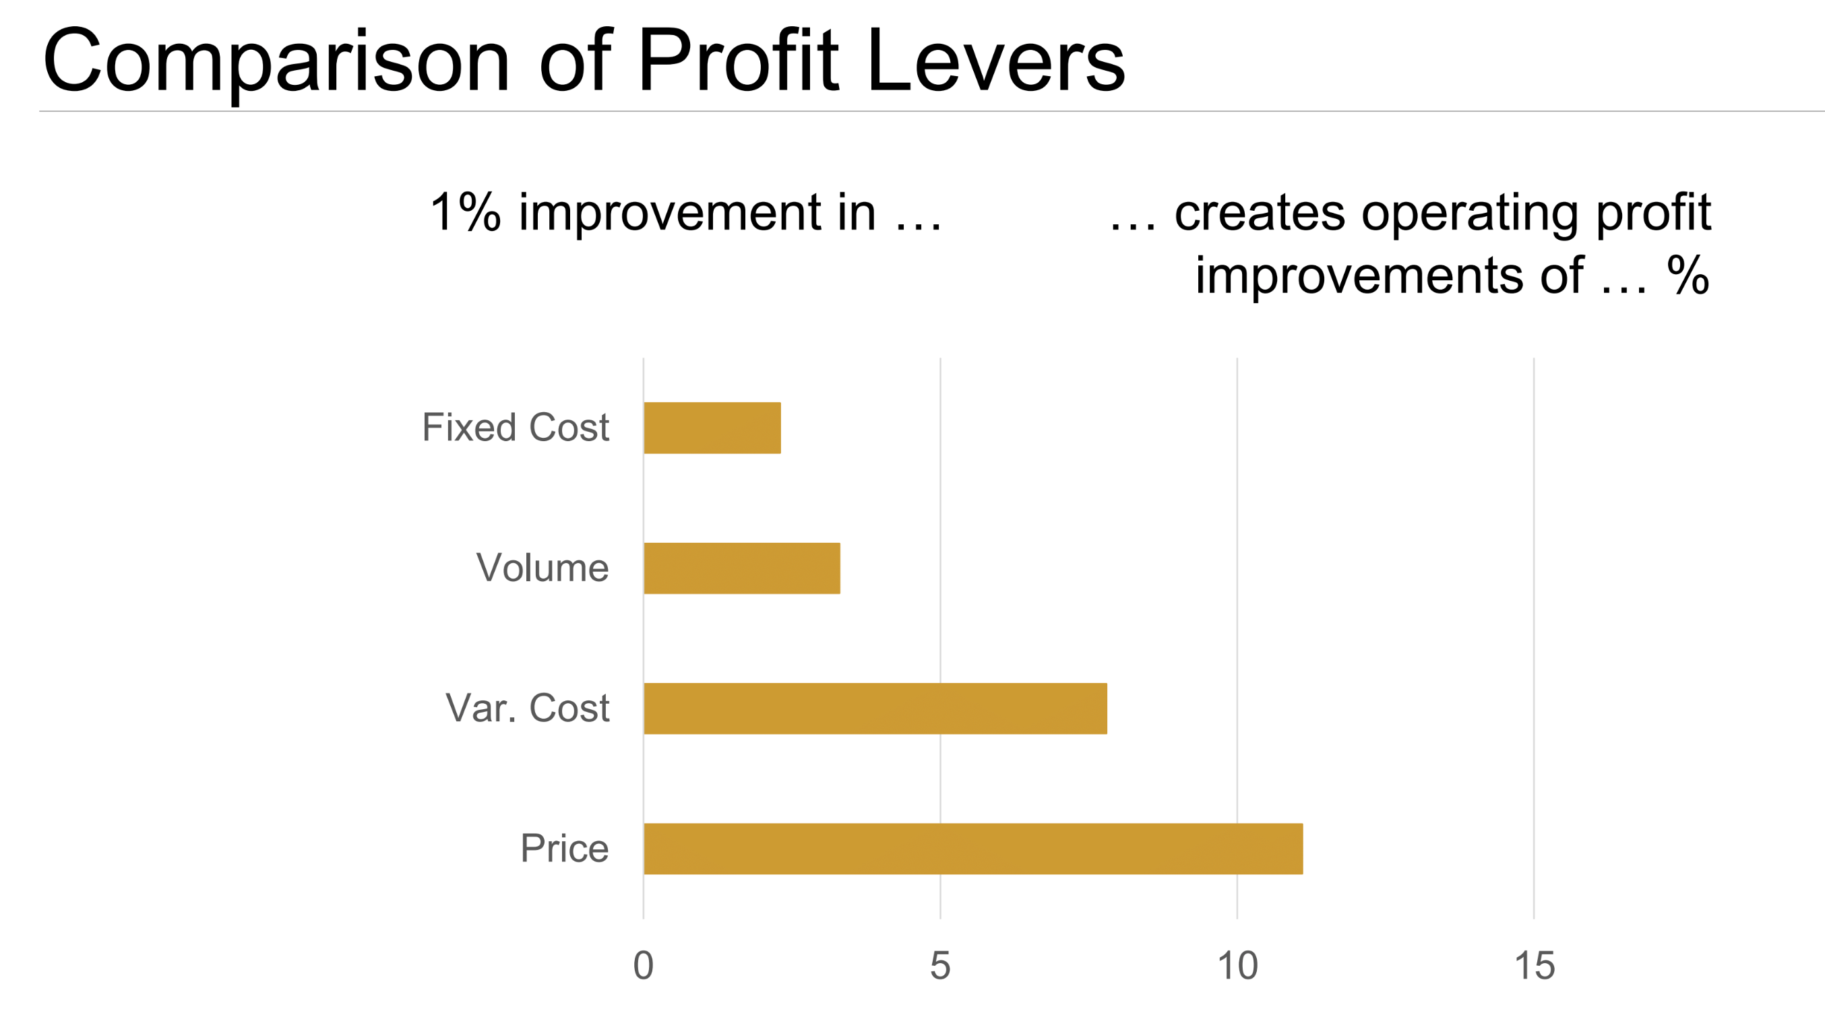
The Power of Good Pricing Unlocking Revenue Growth
2.6%
In 2013, 1% improvement in price would boost profits by:
7.4% at Dupont
10.2% at Nike
18.9% at Boeing
27% at Walmart
3.6%
6.7%
12.3%
Based on average Fortune 1000 company
Source: Deloitte 2013

Slide 15
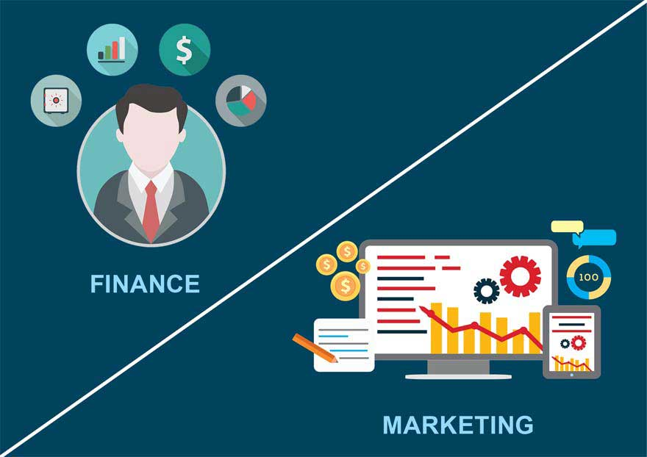
Pricing in the Organization Where should the pricing manager sit?
Pricing should balance customer’s demand for value and firm’s need to cover costs and make profits.
Pricing often handled by finance/accounting because of link to financial performance
This is a mistake! Marketing is best-equipped to understand customer needs and value creation (EVC lecture)
But Marketing needs to understand and consider financial objectives (costs lecture)
Finance vs marketing?

Slide 16
Pricing in the Organization Where should the pricing manager sit?
Pricing should balance customer’s demand for value and firm’s need to cover costs and make profits.
Pricing often delegated to finance/accounting because of link to financial performance ($revenues)
This is a mistake! Marketing is best-equipped to understand customer needs and value creation (EVC lecture)
But Marketing needs to understand and consider financial objectives (costs lecture)

Slide 17
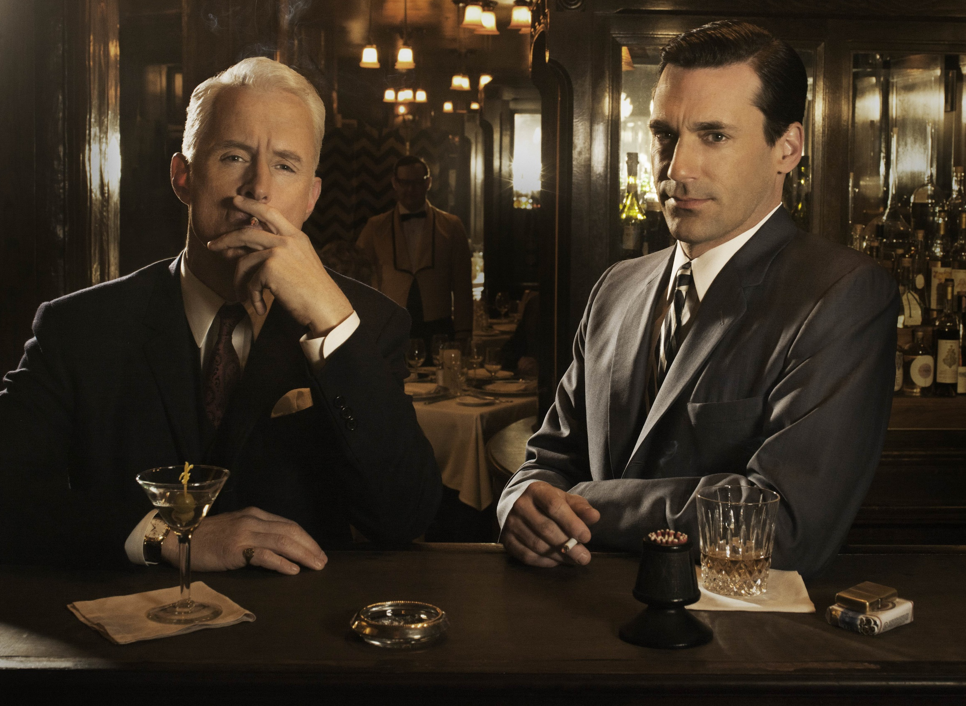
What do marketers do?

Slide 18
Pricing and the Marketing Mix
Marketing drives Revenue Growth!!!!
Marketing decisions to manage customer value:
Identifying profitable new opportunities for value
Creating value
Communicating value
Delivering value to customer
Trading value to customer for money
Product
The
4 P’s
Promotion
Place
Price
Marketing strategy consists of aligning value and pricing to create a profitable enterprise

Slide 19

Pricing in Practice

Slide 20

How does your company set its prices?

Slide 21

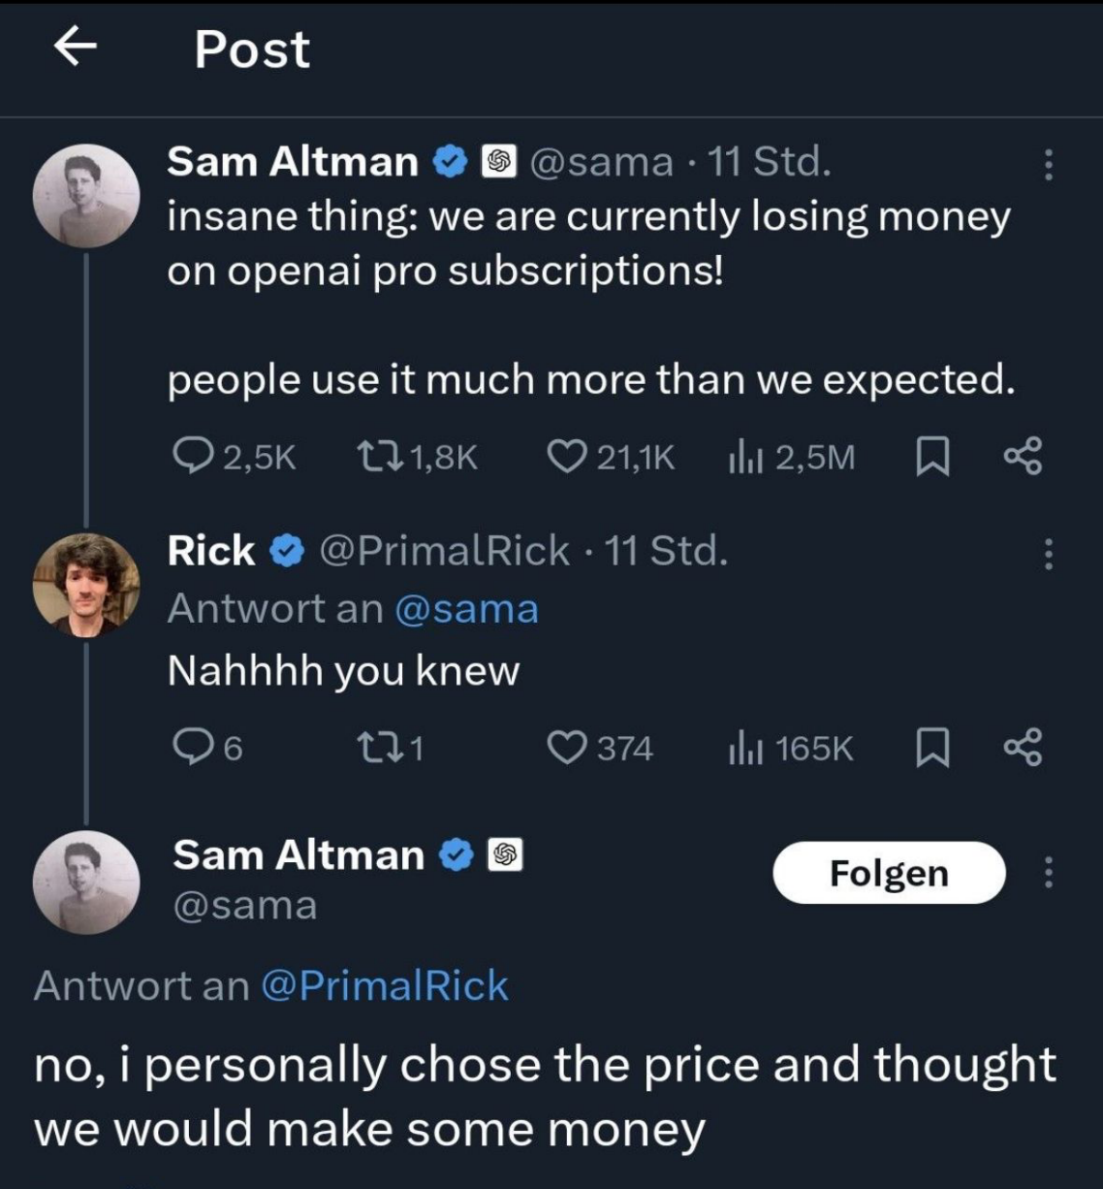
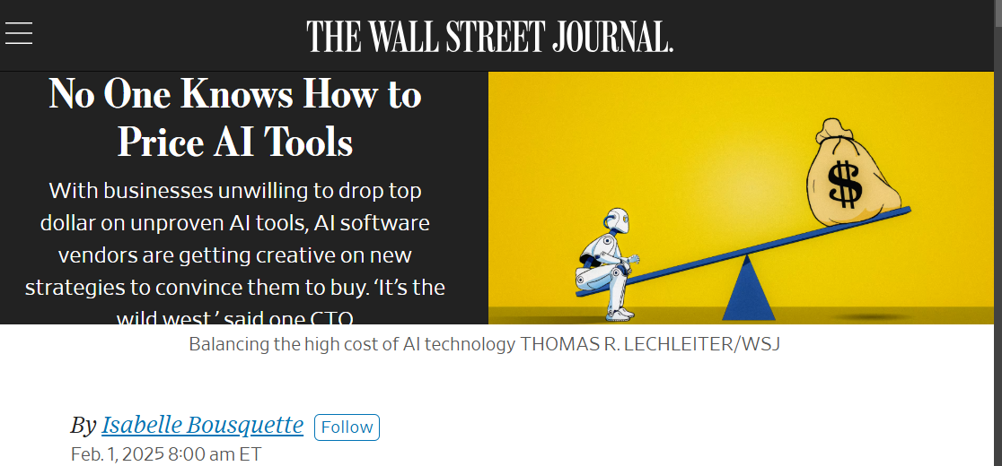

At start-ups, price is often literally a (bad?) guess
Sam Altman
CEO,
January 6, 2025

Slide 22
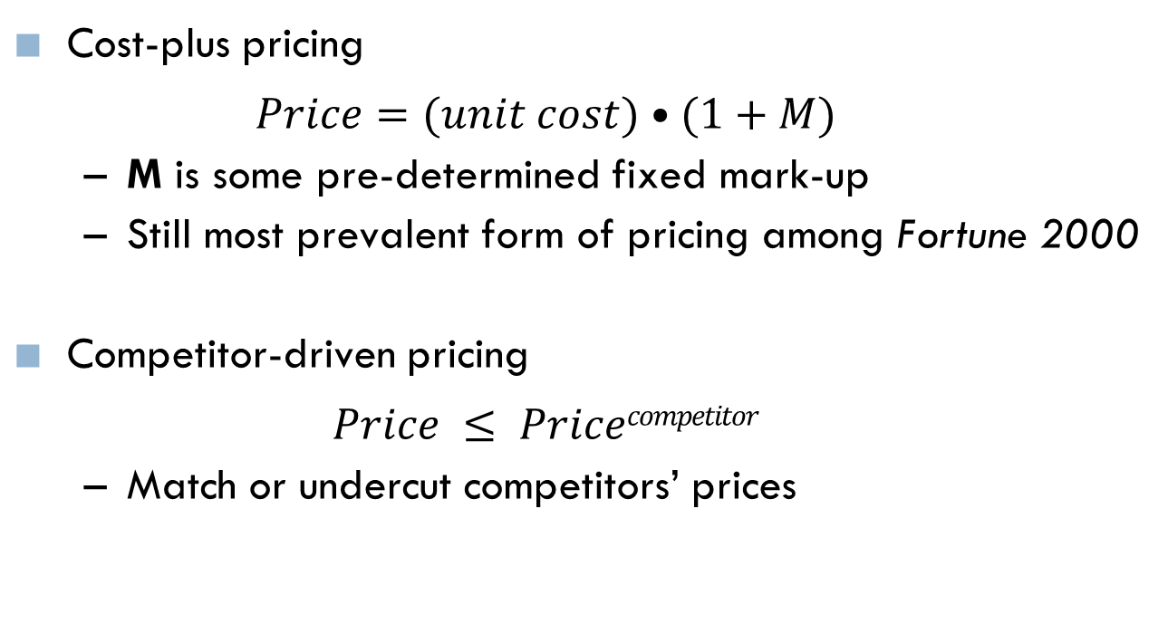
Typical Pricing Rules used in Practice
Cost-plus pricing
$$Price=(unit cost)•(1+M)$$
M is some pre-determined fixed mark-up
Still most prevalent form of pricing among Fortune 2000
Competitor-driven pricing
$$Price ≤ Pricecompetitor$$
Match or undercut competitors’ prices

Slide 23
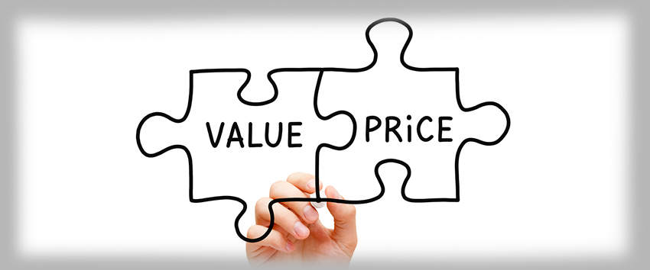
Limitations of Simple Rules of Thumb
?
Cost-plus pricing ignores value
Competitor-driven pricing assumes you create no economic value

Slide 24

The Power of Good Pricing Unlocking Revenue Growth
Ok we established that
Pricing is a Marketing Function
Pricing has power to unlock revenue growth
But how?

Slide 25

Chicago Booth Approach to Marketing
Scientific approach to marketing decisions
What is your theory?
What is your evidence?
Which data/method(s)?
Was it good for business (accountability/evaluation)?
1
2
3
The Chicago-Booth Approach to Marketing teaches you how to use theory and models to analyze the data in a scientific and logical manner

Slide 26
Course Take-Aways Optimized Pricing as a driver of Growth
Design a pricing strategy (theory & evidence)
* simple uniform pricing structure
* sophisticated targeted/segmented pricing structures
Logic: virtues of strategies versus rules-of-thumb
Marketing For Good: ethical, legal, social & P.R. considerations
1
2
3

